Slide 1
Sudoku 8x8 Design
Using backtracking algorithm

Slide 2
Introduction
Sudoku is a logic based combinatorial number placement puzzle.
The simplicity of puzzle’s structure and the low requirement of mathematical skills causes interest in solving it.

Slide 3
The square grids in sudoku are usually 8X8, 9X9, 16X16 or other sizes.
Sudoku Puzzles can be solved using many techniques like back tracking, Stochastic search/optimization methods, Constraint programming, Exact cover, Relations and residuals.
In this project we use backtracking algorithm to solve the puzzle.

Slide 4
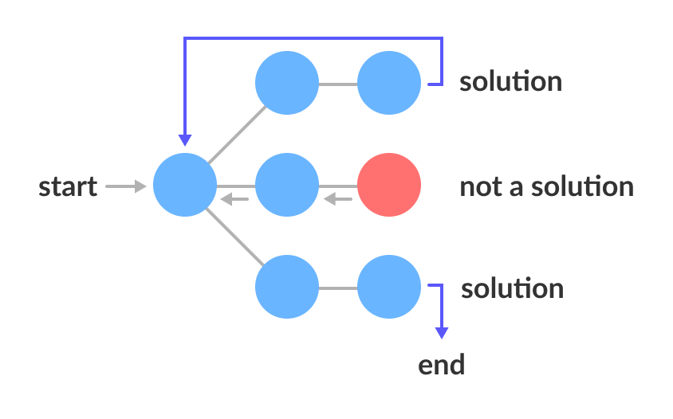
Backtracking Algorithm
Backtracking is an algorithmic-technique for solving problems recursively by trying to build a solution incrementally, one piece at a time, removing those solutions that fail to satisfy the constraints of the problem at any point of time
It’s a modified process of brute force.
Based on Depth first search
Applications:
Tower of Hanoi, N-Queen problem, Sudoku design etc.

Slide 5
Advantages of Backtracking
Advantages of using back tracking
• A solution is guaranteed (as long as the puzzle is valid).
• Solving time is mostly unrelated to degree of difficulty.
• The algorithm (and therefore the program code) is simpler than other algorithms, especially compared to strong algorithms that ensure a solution to the most difficult puzzles.

Slide 6
Problem Statement
The aim of the project is to develop a sudoku puzzle of 8x8 dimensions using backtracking
The aim of the puzzle is to enter a numerical digit from 1 to 8 in each cell of a 8X8 made up of 2X4 sub-rectangles, at the start only a few numbers are revealed. each row, column and sub-rectangles region must contain each of the number 1 to 8 exactly once.
As the problem here is solved using the back tracking method, Each cell is tested for a valid number, moving "back" when there is a violation, and moving forward again until the puzzle is solved.

Slide 7
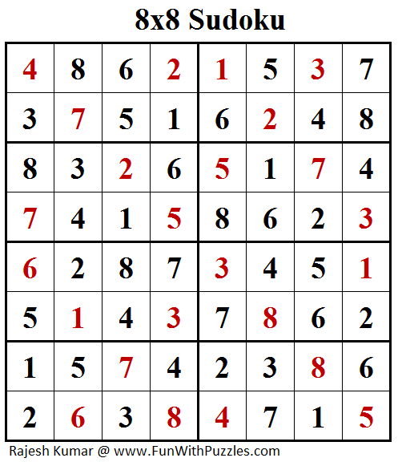
Rules
Every square (cell) has to contain a single number
Only the numbers from 1 through to 8 can be used
Each 2x4 box can only contain each number from 1 to 8 once
Each vertical column can only contain each number from 1 to 8 once
Each horizontal row can only contain each number from 1 to 8 once

Slide 8
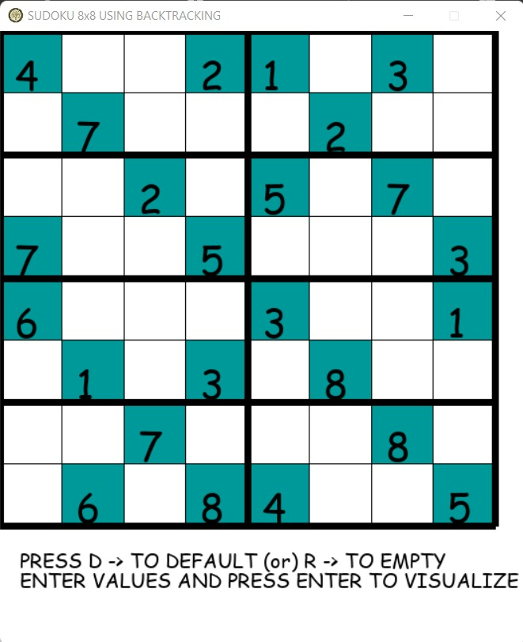
Methodology
Initialize the sudoku window with any random grid values
Search for patterns using rules
Solve the puzzle by visualization
Solve by backtracking

Slide 9
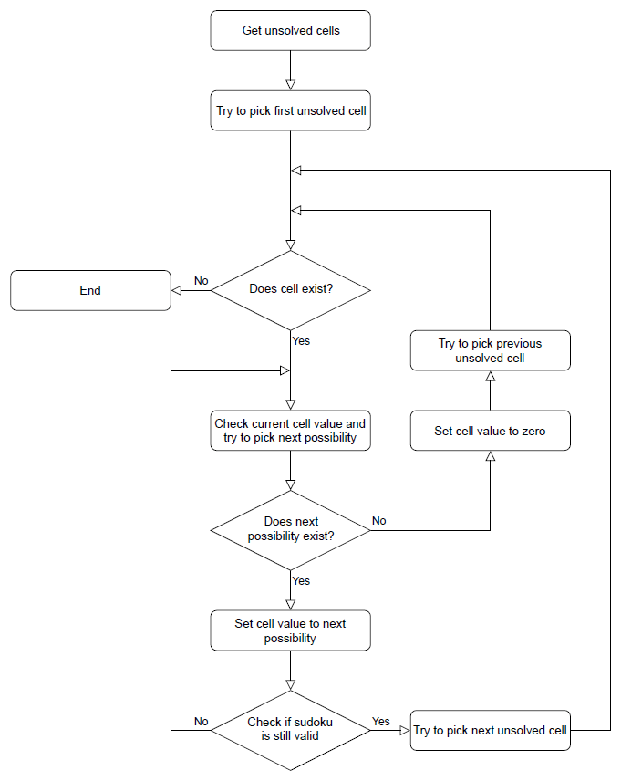

Slide 10
Here come’s the execution

